Slide 1

Tracking Adversaries With MMH3 and JARM Hashes
Krishna Mungur
Fifth Third Bank
Notes:
Krishna Mungur got his start with intelligence at the end of the Cold War.
He has worked extensively with defense contractors, government, and military, and also supported law enforcement.
Additionally, he has worked as a critical infrastructure analyst and currently serves Fifth Third Bank as a Cyber Threat Intelligence Analyst
Along the way, he has developed numerous intelligence platforms that benefit the Intelligence Community, and also retooled some of them for the private sector.
Also, he has numerous publications in professional and academic press, as well as conference presentations.

Slide 2



MMH3 and JARM and Hashes
MMH3
JARM
https://github.com/mungurk/adversary_tracking/
2.26
Notes:
Today we will cover a couple advanced techniques for tracking adversaries through MMH3 and JARM hashes
We will look at advanced techniques for discovering criminal actor infrastructure, as well as strategies for takedowns
You should come away with a healthy mix of both tactical and strategic knowledge, and specific ways to implement what we talk about
You will see a single link to my Github at the bottom of all three resource slides; all resources we cover in this presentation are linked there

Slide 3
MMH3 and JARM and Hashes
MMH3
JARM
3.26
Notes:
MurmurHash is a non-cryptographic hash function created by Austin Appleby in 2008.
Unlike cryptographic hash functions, and there was even a contest for reversing MurmurHash.
For this reason, it not good for cryptography.
Despite the potential for collisions, MurmurHash is actually really valuable in neural networking.
But for our use case today, we will look at adversary tracking, and even a nice use case for bug bounties.

Slide 4
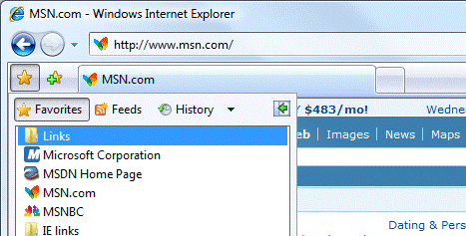
Installing Murmur Hash
These are Favicons
4.26
Notes:
MurMurHash allows you to calculate a hash value for the favicon graphic.
This is the little 16x16 or 32x32 icon that shows up on the browser tab, and they used to display in the address bar.
At Fifth Third Bank, we track multiple actors that set up bogus sites for credential harvesting.
When we study the websites, they often include the Favicon graphic.
Wouldn’t it be useful to proactively identify these websites, and issue takedown orders.
That’s where MurMurHashing comes in.

Slide 5

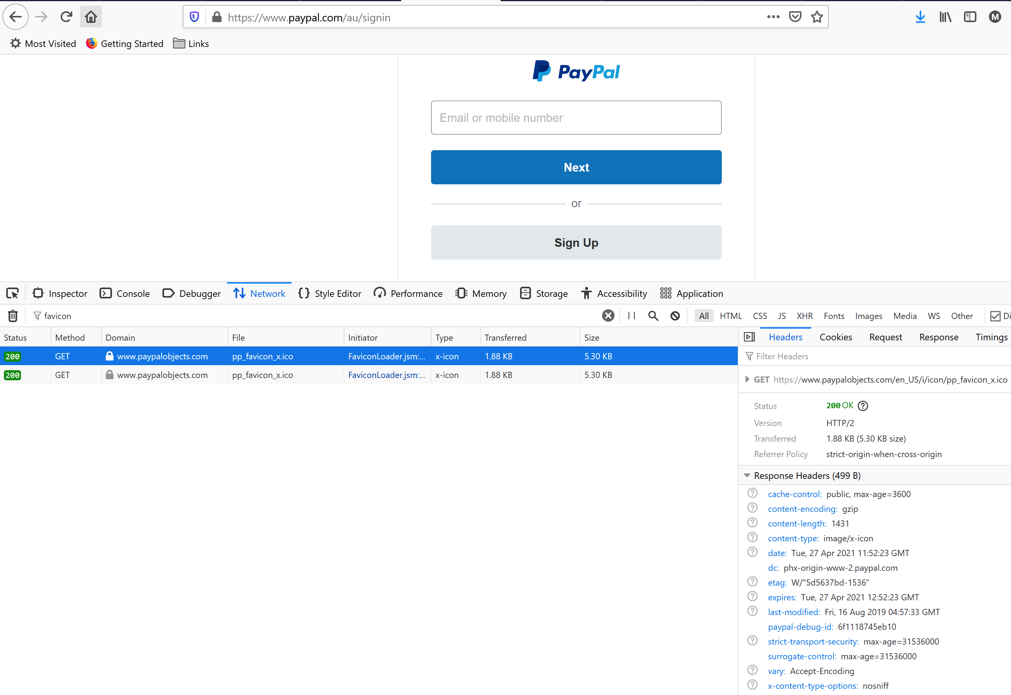


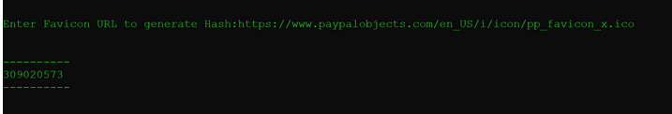
Retrieving the FavIcon
FavIcon on Tab
5.26
Notes:
It turns out that credential harvester actors really like to use HTTrack, an impressive application that effectively creates a near-exact clone of websites
When they use HTTrack, the application tends to include the Favicon by default, and by including that little graphic, the result looks more compelling to a potential victim.
So now, enter MurMurhash.
First, we want the exact URL of the Favicon, so we can feed it to MurMurhash.
One really simple way is to view the source, and extract the path

Slide 6
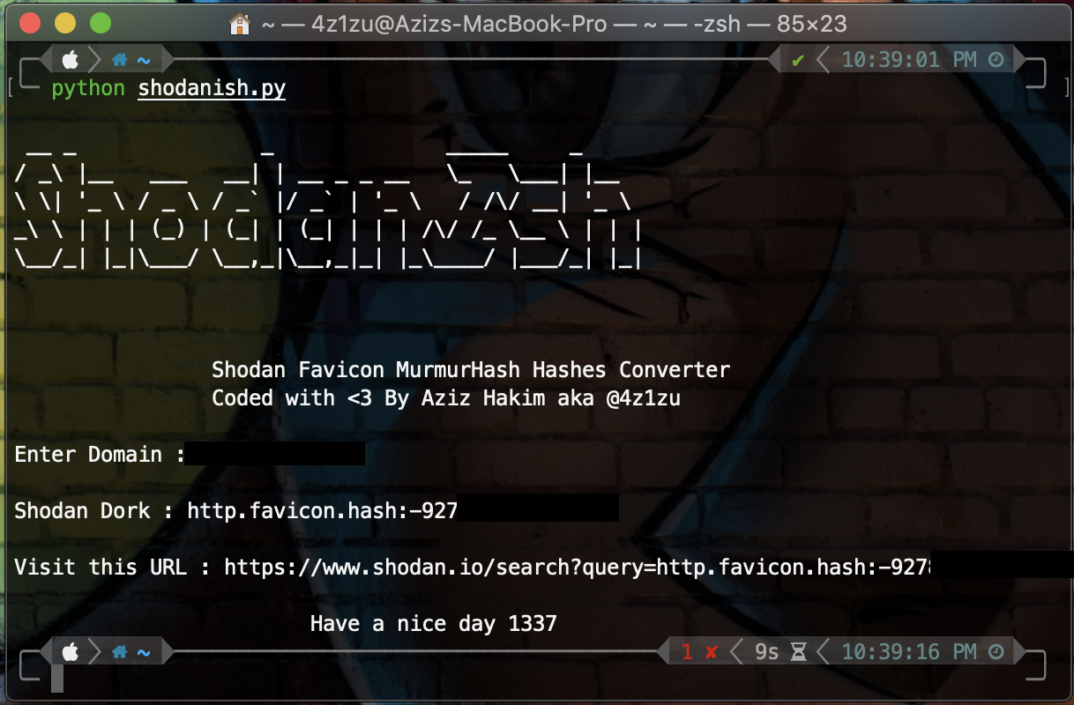

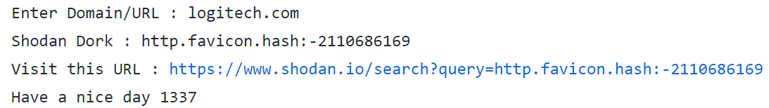
Calculating the Murmur Hash
https://github.com/ninoseki/mmhdan https://mmhdan.herokuapp.com/
6.26
Notes:
To get the MurMurhHash, we can use the ShodanIsh project
ShodanIsh is available on GitHub, run it and provide your domain.
ShodanIsh calculates the favicon and generates a Shodan URL to query

Slide 7
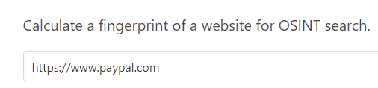
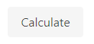




Calculating the Murmur Hash
https://shodan.io/search?query=http.favicon.hash%3A-475477415
https://urlscan.io/search/#5470eef277cb306a2c9fc28f37b185f3c1138ac5a965fd198df32bf8285a07c3
https://app.binaryedge.io/services/query?query=http.favicon.md5%3A85916ebde1cf7668a22f84b819830695
https://spyse.com/advanced-search/domain?search_params=%5B%7B%22domain_info_favicon_hash%22%3A%7B%22value%22%3A%225470eef277cb306a2c9fc28f37b185f3c1138ac5a965fd198df32bf8285a07c3%22%2C%22operator%22%3A%22eq%22%7D%7D%5D
https://github.com/ninoseki/mmhdan https://mmhdan.herokuapp.com/
7.26
Notes:
Once we have the hash value, we can hunt for other websites that have the same hash value as our Favicon.
Fortunately, there are several third-party services that you can query for MurMur hashes.
If we begin with MMH Dan, also from Github, we enter the domain
Then, click calculate and not only do we get the MurMur Hash, but four URLs for third party services

Slide 8
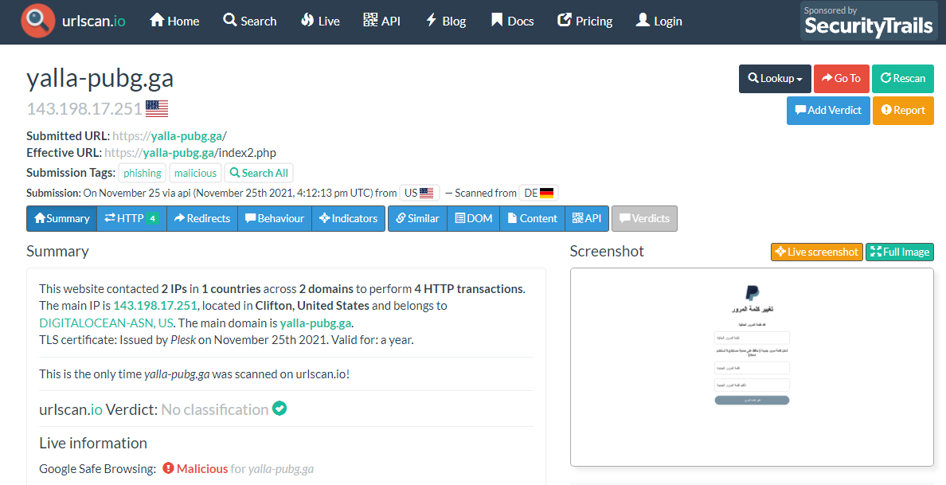
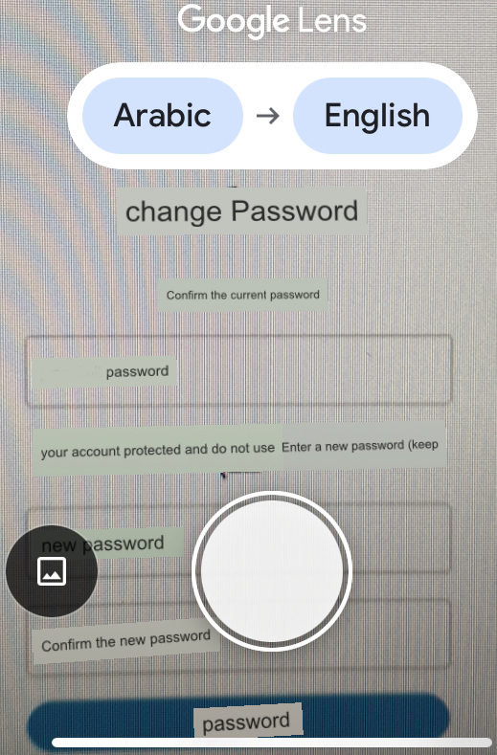
Identifying the Malicious Infrastructure
https://urlscan.io/search/#5470eef277cb306a2c9fc28f37b185f3c1138ac5a965fd198df32bf8285a07c3
https://github.com/ninoseki/mmhdan
8.26
Notes:
Once we have the hash value, we can hunt for other websites that have the same hash value as our Favicon.
Fortunately, there are several third-party services that you can query for MurMur hashes.
Here we found a website with the same FavIcon as PayPal, on the URLScan.io website
You will notice in the lower left corner, circled in red, that Google has flagged the site as malicious
Then we have a screenshot to the right of it, also circled in red.
In case your Arabic is not as good as your English, I used the Google Translate app on my iPhone
This is a pro-tip, because the smartphone app will display a translation right there on the screen of your phone
Here, we show that with the green arrow
So, we have a site we have detected through MurMur hashes that is excellent for a takedown request

Slide 9
MMH3 Resources
HTTrack https://www.httrack.com/
MMHDan https://github.com/ninoseki/mmhdan
MMHDan Demo Site https://mmhdan.herokuapp.com/
ShodanIsh https://github.com/eternyle/ShodanIsh
BinaryEdge https://www.binaryedge.io/
Shodan https://www.shodan.io/
Spyse https://spyse.com/
urlscan.io https://urlscan.io/
https://github.com/mungurk/adversary_tracking/
9.26
Notes:
Before we transition to Takedowns and then JARM hashes, we have some of the top resources for MurMur hashes
Please notice the link to my Github at the bottom of the screen, all resources we cover in this presentation are linked there
The left column is completely free resources
The right column are commercial but allow a small number of lookups with an account

Slide 10

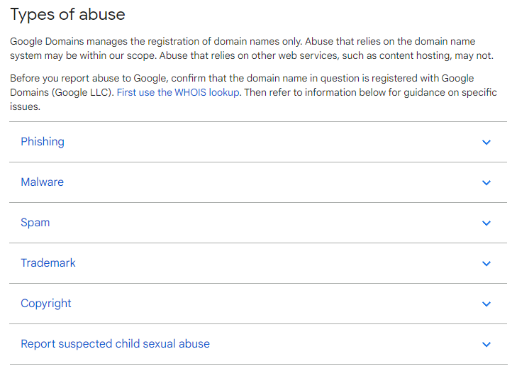
Takedown Request Resources
https://support.google.com/domains/answer/10093434
https://github.com/mungurk/adversary_tracking/
10.26
Notes:
Takedown requests typically fail unless there is a clear trademark or copyright violation
Google is one single party to reach out to for takedown requests, and the service is free
But with free, they are not exactly fast to respond, but they will take a look at the submission and process the request
There are other third-party commercial services that will issue takedown requests for a fee, and can vary greatly in their quality
But to emphasize again, the complain needs to have a clear, visible trademark or copyright violation
Just registering an impersonation domain will probably not result in a takedown, it’s when the violation can be observed
Everything we just went over on takedown requests for MurMur hashes applies to JARM as well, which we will look into next

Slide 11






JARM was created by: John Althouse Andrew Smart RJ Nunnally Mike Brady
11.26
Notes:
In November 2020, SalesForce announced its work around profiling servers based on details in their TLS configuration.
Fun fact, the name “JARM” is an acronym taken from the first names of the four Salesforce engineers who developed JARM
They published Python code to transmit 10 TLS Client Hello messages to a target server.
If the server accepts TLS connections, it responds with a corresponding packet for each Hello message.

Slide 12




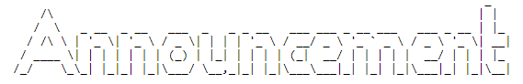
Server HELLO
OS Type
OS Version
Libraries Used
Library Versions
Order Libraries Called
Custom Configuration
12.26
Notes:
The Server Hello response is built to report back on several configuration items and depend on how the target server is configured.
These packets have been picked to prompt unique responses in TLS servers, with different TLS versions, ciphers, and extensions in varying orders to gather unique responses:
Type of Operating system
Version of Operating system
And then most importantly
Any libraries used
What library versions are used
The order in which the libraries were called
Custom configuration

Slide 13
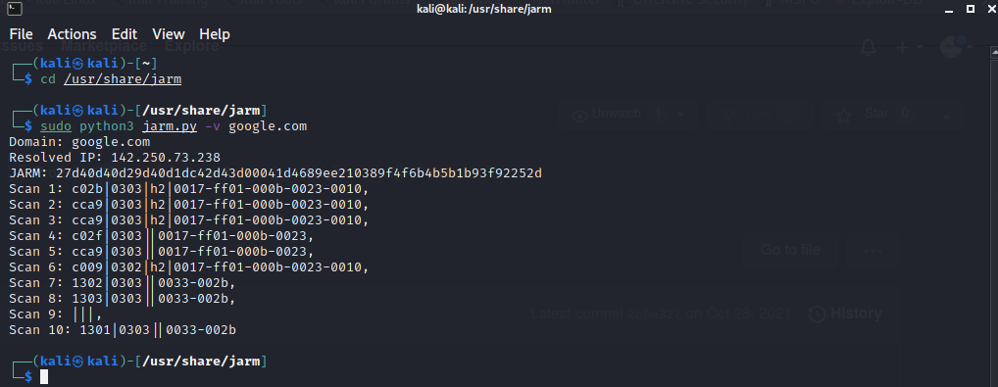



JARM
Library configuration
Packets transmit TLS responses
13.26
Notes:
The Python script then runs the packets through its algorithm and generates a 62-digit hash of the results.
Remember we started with 10 packets, and each packet is accounted for in three digits of hex.
So three digits times ten packets brings us to thirty, and the last 32 digits are to do with the libraries and their configuration.
In effect, a JARM hash is a hybrid between the TLS responses and a SHA-256 of the library configuration.

Slide 14
JARM
Library configuration
Packets transmit TLS responses
14.26
Notes:
So, if you have two servers where the first 30 characters match, then they have the same TLS configuration.
Then the final 32 characters are a hash of the server libraries.
That may mean the same group owns and operates them.
An exact match of multiple servers with the same JARM is a pretty strong indicator the servers could be related, but this is not definitive.
For some additional context, when comparing a given JARM fingerprint against the Alexa Top One Million websites, there was no overlap.

Slide 15



JARM & Hosting Providers
15.26
Notes:
For example, in the case of rented infrastructure, let’s say a group of web servers at Digital Ocean, they have the same owner, but may be operated by numerous companies renting out that server.
It is definitely possible to encounter false positives, if two servers just happen to be configured the same exact way, and we are aware of some of these.
Also, patches may be run unevenly across a fleet of servers, so that could also account for a difference in the JARM hash values.

Slide 16

Cobalt Strike Example
16.26
Notes:
So, imagine a use case where you identify a Cobalt Strike server, and then calculate a JARM hash value of that server.
What can you do with that hash?
Well, here’s where third-party services that enable JARM queries comes into the equation.

Slide 17



Cobalt Strike Example
17.26
Notes:
So, sticking with out Cobalt Strike example, if you use the right syntax for that platform, you can then search for servers that each platform knows about and identifying other Cobalt Strike servers.
When scanning Trickbot Malware C2s from a list compiled by abuse.ch, for 80% of the live IPs on the list produced the same JARM fingerprint.
Since there is potential for false positives, you might not want to think of this as an automatic “block list” but rather as a list of infrastructure nominated for more review.
What kind of review? Does that server host known bad domains, are there malware samples that communicate with it, what about reputation lists, and so on.

Slide 18









Platforms Supporting JARM
360 BinaryEdge Censys
Palo Alto Networks PassiveTotal RiskIQ
SecurityTrails Shodan VirusTotal
18.26
Notes:
JARM support has been or is being added to each one of the third-party vendors listed here
We are not endorsing any of these, just trying to be thorough with our list
Some of these vendors include additional features, for instance including fuzzy searches
Many of these vendors also include JARM through the command line
Please note that running JARM through a vendor is not the same thing as executing JARM from your own desktop against the target
The vendor tool is merely displaying content they have previously indexed and spitting it back at you
It’s not bad, it’s just not live data, and that may be great if the server is actually down right now and was live when the vendor scanned it

Slide 19

TA505 Example
19.26
Notes:
Here’s a second use-case, involving the cybercrime actor TA505
Let’s say we collect intelligence on a couple dozen suspected domains that are tied to SERVHELPER, a favorite TA505 backdoor
We can calculate JARM values, for these, developing a signature that matches the configurations common to SERVHELPER.
We could then leverage a third-party vendor to alert us of new matches to that SERVHELPER JARM value
If we get a match, we treat it as a nominated domain, not as a definitive verdict
Perhaps we start looking for any samples that communicate with that domain, for instance
Or we look at the ASN, the hosting provider, what else is hosted on that IP, inspecting the certificate, or consider the DNS records
These can help make the case for moving a nominated domain through the process of validation

Slide 20
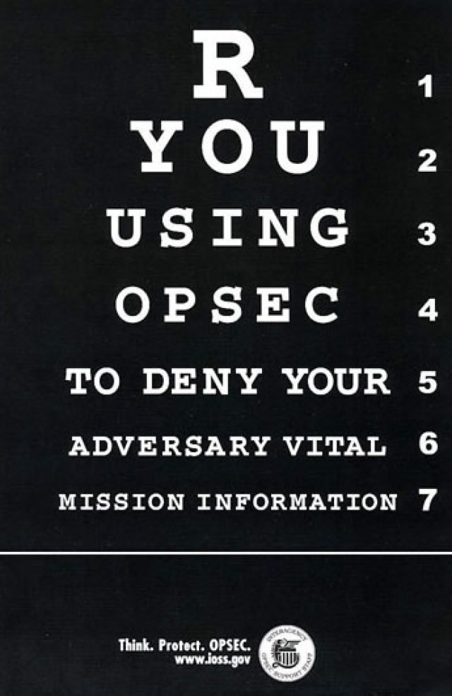
20.26
Notes:
Now let’s take a step back and consider how we interact with servers via JARM, and the strengths and weaknesses of each approach, because there are definite capabilities and shortcomings to all.
We started with the SalesForce python script, now this is NOT a passive scan, if you run this from your machine against your target server, they could potentially tie this scan to you.
Now it is not a huge scan, it’s a tiny blip of traffic, but if you are scanning a nation-state backed cyber actor, at the very least run these through a VPN or proxy server.
Also, running a Python script against a server is a live operation, so and results will be the most recent snapshot in time of how that server was configured and how it responded at that time.

Slide 21

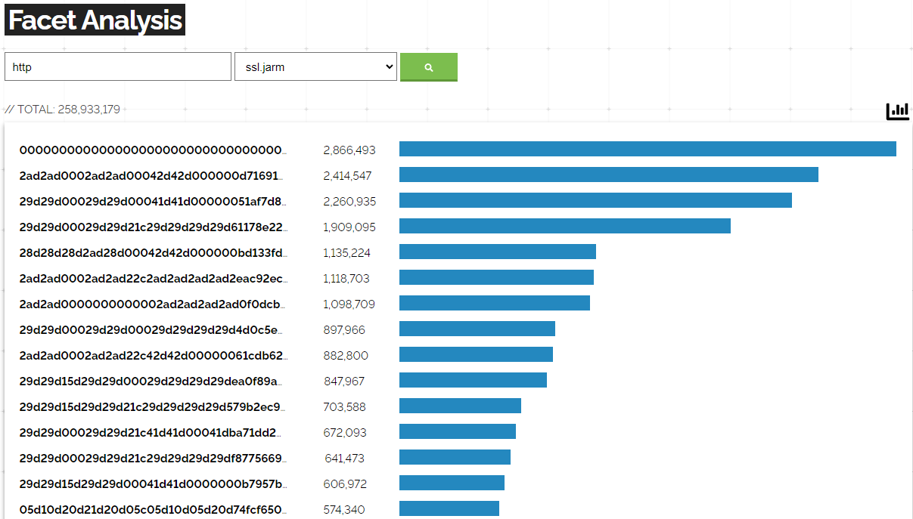
Shodan JARM Facet Analysis
21.26
Notes:
Shodan even publishes its own “Facet Analysis” that displays discovered TLS instances and their generated JARM hash values.
Earlier we mentioned that “zeroes” in the first thirty characters of the JARM mean no response on that Hello packet, so it could be a configuration issue, effectively a block of three zeroes denotes indicates the server refused to negotiate with that client hello.
However, straight zeroes throughout could also mean the server is currently down.
The server owner could be rebooting the system, it could be down for maintenance, or down until an actor is ready to execute a campaign, so these are all factors in live JARM scans from the Python client.

Slide 22




JARM & Search Resources
22.26
Notes:
What about running JARM queries from a search engine, such as the Shodan, VirusTotal, and PassiveTotal platforms we referenced earlier? These search engines do not execute a new JARM query when you run a search in their platforms.
The results can take 60 seconds or so to come back, and the search engines are all about delivering results to you as quickly as possible.
To do this, they simply run a lookup of their internal database, also called a search index, to tell you what they know about what you were looking for.

Slide 23

JARM & Search Resources
23.26
Notes:
Therefore, the results coming back from and search engine are only as good as the last time the search engine updated its index.
And that’s true for any search engine, JARM or not, so it may be that the search engine has zero results and your own query pulls up the very latest results.
However, your own query probably won’t scale as well as a huge cluster of search engine servers could.
But that search engine could be fantastic for correlating which servers match your JARM across its entire index, so there is still some definite value to that.

Slide 24


JARM Randomizer
24.26
Notes:
Another factor with false positives is a project called JARM Randomizer
Security researchers from developed a Github project for forging responses to the fingerprinting calls from the Python client.
JARM Randomizer then spits back inaccurate data
Does this mean JARM is now useless?
No, not really, although hard numbers on JARM users are very hard to come by, but we can safely say it is a tiny fraction of users
From that, we can further subdivide that tiny fraction of users into a much smaller subset that are deliberately deploying fabricated JARM values
By way of comparison, most web servers operate on the world wide web, and a much smaller fraction are on Tor
Simply put, JARM is not well known enough at this stage, but in the future, probably if someone created a “JARM Evasion” tool, made it easy to use, and baked it into a popular framework, then maybe.
But for now, JARM remains incredibly powerful and certainly relevant, but not foolproof.
JARM should not be used as a blocklist generator, but it can be a valuable step in that direction.
Earlier we spoke of using JARM as a nomination engine, to identify potential infrastructure to investigate.

Slide 25
JARM Randomizer
25.26
Notes:
By way of comparison, most web servers operate on the world wide web, and a much smaller fraction are on Tor
Simply put, JARM is not well known enough at this stage, but in the future, probably if someone created a “JARM Evasion” tool, made it easy to use, and baked it into a popular framework, then maybe.
But for now, JARM remains incredibly powerful and certainly relevant, but not foolproof.
JARM should not be used as a blocklist generator, but it can be a valuable step in that direction.
Earlier we spoke of using JARM as a nomination engine, to identify potential infrastructure to investigate.
When properly understood, not just its strengths but the weaknesses too, JARM can be a powerful ally in proactively identifying attack infrastructure, often before it is even ready for production by the adversaries.

Slide 26
JARM Resources
Github JARM Project https://github.com/salesforce/jarm
Salesforce JARM Blog https://engineering.salesforce.com/easily-identify-malicious-servers-on-the-internet-with-jarm-e095edac525a
A Red Teamer Plays With JARM https://www.cobaltstrike.com/blog/a-red-teamer-plays-with-jarm/
Shodan Facet https://beta.shodan.io/search/facet?query=http&facet=ssl.jarm
PaloAlto’s pyJARM https://github.com/PaloAltoNetworks/pyjarm
JARM Randomizer https://github.com/netskopeoss/jarm_randomizer
https://github.com/mungurk/adversary_tracking/
25.26
Notes:
Before we transition to my contact information, we have some of the top resources for JARM
Lastly, we are concluding with some selected JARM resources.
Now the PaloAlto project is a rewrite of the original JARM code to make it callable as a library and added proxy support.

Slide 27

Questions & Answers
LinkedIn https://www.linkedin.com/in/krishna-mungur-49887a4
Twitter https://twitter.com/mungurk
WikiLeaks https://icwatch.wikileaks.org/search?utf8=%E2%9C%93&area_facet=Cincinnati+Area&tools_mentioned_facet=Crisis+Management&type_facet=Privately+Held&q=krishna+mungur
https://github.com/mungurk/adversary_tracking/
26.26
Notes:
As promised, my contact information is displayed in the slide

